Slide 1
Fake Currency Detection (An Application to detect counterfeit currency)
DONE BY:
SRIRAM KARTHICK K - 311619104073
VARUN KUMAR - 311619104079
IV year CSE/MNMJEC
GUIDE NAME:
Mr. V.VINOTH KUMAR, B.E., M.E.
ASSISTANT PROFESSOR/CSE/MNMJEC

Slide 2
Table of Contents
S.NO | CONTENT
1 | Abstract
2 | Existing System
3 | Proposed System
4 | Literature Survey
5 | Introduction
6.1 | Hardware Requirements
6.2 | Software Requirements
7 | System Architecture Design
8 | Modules
9 | Use Case Diagram and Activity Diagram
10 | Code
11 | Result and Analysis
12 | Conclusion and Future Enhancement

Slide 3
List of Figures
S.NO | CONTENT
7.1 | System Architecture
9.1.1 | Use Case Diagram (Application Frontend)
9.1.2 | Use Case Diagram (Application Backend)
9.2 | Activity Diagram
11.1 | Loss Graph of the model
11.2 | Accuracy of the model

Slide 4
Base Paper Details
Aman Bhatia, Vansh Kedia, Anshul Shroff, Mayand Kumar, Bickey Kumar Shah, Aryan,
“Fake Currency Detection with Machine Learning Algorithm and Image Processing”, DOI:10.1109/ICICCS51141.2021.9432274

Slide 5
1. Abstract
Fake currency detection using image processing and Machine learning techniques, specifically Convolutional Neural Network (CNN) algorithm, for detecting fake currency in India.
The proposed approach utilizes image processing techniques to extract features from currency images and then applies CNN algorithm to classify the authenticity of currency notes.
A CNN is a kind of network architecture for deep learning algorithms and is specifically used for image recognition and tasks that involve the processing of pixel data.
In the dataset we can collect the dataset of 100 and 50 notes of fake currency and Real currency notes.
The proposed approach shows promising results and can be further improved by incorporating additional features and refining the training process
The accuracy which we have achieved is 75%.

Slide 6
2. Existing System
In the existing system, different traditional strategies and methods are available for fake currency identification based on the colors, width, and serial numbers mentioned.
Processing these attributes by using digital technologies will give high false positive results leading to lower accuracy of the technology.
In this system First, to classify the nationality to use certain predefined rules. Areas of significance, and then derive the denomination value.
Using features such as scale, color, or script on a note, based on how distinctive the notes are in the same region.

Slide 7
3. Proposed System
Our proposed solution/system is to use Convolutional Neural Network (CNN).
A CNN is a kind of network architecture for deep learning algorithms and is specifically used for image recognition and tasks that involve the processing of pixel data.
Convolutional Neural Networks (CNNs) are a popular choice for image processing tasks like fake currency detection for several reasons:
Local feature extraction
CNNs is a model which is designed to perform local feature extraction by applying a set of filters or convolutional kernels on the input image.
This helps in capturing the spatial relationships between different pixels in an image and identifying local patterns or features that are important for detecting fake currency.

Slide 8
Robust to image variations
CNNs are robust to variations in the input image, such as changes in lighting conditions, orientation, and scale.
This is important for fake currency detection as counterfeiters often try to mimic the appearance of genuine currency, and the CNN can still identify fake notes despite such variations.
High accuracy
CNNs have been shown to achieve high accuracy in various image classification tasks, including fake currency detection.
They can learn to differentiate between genuine and fake notes based on subtle differences in texture, color, and other features.
Convolutional Neural Network is trained considering three train test ratio 80:20, 70:30 and 60:40 and measured their performance on the basis various quantitative analysis parameter like Precision, Accuracy, Recall, MCC, F1-Score and others.

Slide 9
4. Literature Survey
In [1], In the past studies the data collected for the fake note detection was with professional cameras but in those data, accuracy seen was to be fair and good due to simple machine learning algorithms. Convolutional Neural Network algorithms were used traditionally for the detection of fake notes. Systems were getting slower when the data size became large. After that system came across to classify the precision and recognition rate with some enhancement in Machine learning algorithms and deep learning concepts
In [2], Due to high and large data sets, data sets were getting distorted, and the precision was not effective a lot though it was 98%. All of these detections were carried out earlier only with open cv and python but time and again with modern deep learning techniques data were collected with the count of 100 images per denomination and then measured.

Slide 10
In [3], In 2021 the fake note is being detected with the algorithms of efficient Machine learning, Deep convolutional neural network, and followed by image processing. It has shown the efficiency to be maximum in today's days.
In [4], Accuracy of training and testing sets were measured. This brings the chain type efficiency that elongates to a larger value in comparison to other techniques. Concept of the transfer learning was used in the system. The noise was also captured, and this was another problem due to which much more advancement was required. After that, a Convolutional neural network came into the measurement for the error elimination. Loss trends were generally analyzed concerning training loss (TL) and validation loss (VL). Accuracy trends were generally analyzed by training accuracy (TA).

Slide 11
5. Introduction
A fake currency detection using machine learning algorithms and image processing techniques. The objective of this study is to develop an efficient and accurate method to detect counterfeit banknotes using Convolutional Neural Network (CNN) and image processing. The proposed system was trained and tested on a dataset of 400 banknote images captured using mobile phones, with a resolution of 512*720 pixels.
Fake currency is a significant problem worldwide, and it is essential to detect counterfeit banknotes as early as possible to prevent financial losses. With the advancements in machine learning and computer vision, automated detection of counterfeit currency has become feasible. In this paper, we explore the use of deep learning techniques to classify banknotes as genuine or fake.
The proposed system utilizes a Convolutional Neural Network, which is a deep learning algorithm commonly used in image classification tasks. In addition, we employed various image processing techniques such as image pre-processing, feature extraction, and dimensionality reduction to enhance the performance of the system.

Slide 12
Our experimental results demonstrate that the proposed method achieved an accuracy of 75%, which outperforms existing methods for fake currency detection. We also conducted a comparative analysis of different deep learning models and evaluated the performance of our system on a real-time dataset.
In conclusion, the proposed method provides a promising solution for detecting counterfeit banknotes using machine learning algorithms and image processing techniques. This approach can be further enhanced with a larger and more diverse dataset, which can lead to improved accuracy and robustness of the system.

Slide 13
6.1 Hardware Requirements
8GB RAM
AMD 3600 processor or an equivalent Intel processor
GPU of 4gb
2GB storage capacity

Slide 14
6.2 Software Requirements
Python
Jupyter Notebook
Visual Studio Code
Nodejs
Android Studio

Slide 15
7. System Architecture Design
Dataset of raw currency image
Dataset pre-processing
Camera
Model Building
Cropping of Image
Capturing image
Scaling up of data
1
Middleware
Web Communication
Converting Image into array
0
Output
Convolutional +ReLU
Pooling layer
Dense Layer
Output
Flatten layer
Splitting of data
Convolutional Neural Network
Fig 7.1 shows that the system architecture of the project

Slide 16
Fig 7.1 shows that the system architecture of the project.
Dataset of 800 banknote images, each of size 512*720 pixels.
Preprocessing of images to enhance quality and remove noise.
Building a CNN model to classify images as genuine or fake.
Developing an application with Android Studio for frontend and Node.js for backend. Web communication used to enable communication between frontend and backend.
User uploads banknote image through GUI on mobile device. Frontend sends image to backend using web communication.
Backend processes image using CNN model. Classification result is returned to frontend.
System can detect counterfeit banknotes using machine learning and image processing techniques.

Slide 17
8. Modules
Data Collection
This is the first step for creating an unbiased model. The quality of the dataset is as important as the quantity of the dataset, as bias can be induced easily. The crucial part of data collection is feature selection, involves choosing the most relevant features from the raw data.
This is important because using irrelevant or redundant features can negatively impact the performance of the machine learning models.
Techniques such as correlation analysis, mutual information, and recursive feature elimination can be used for feature selection.
DATA PRE-PROCESSING
This involves cleaning, normalizing, and transforming the raw data to make it suitable for analysis. The main techniques used in data preprocessing are data cleaning, data transformation, and feature engineering.
This step helps to improve the accuracy of the model which we are training. This process is done in order to remove redundancy and in appropriate data.

Slide 18
MODEL BUILDING
In this module the main part is choosing the appropriate algorithm for finding the fake currency from the properties of the image which is given.
For our project we have concluded to use Convolutional Neural Network detect the fake currency, as CNN algorithm keep adding new data to the dataset, the prediction is adjusted without having to retrain a new model. So It is easy to keep the model up to date.
TRAINING AND TESTING
This process involves many iteration of model training with the data which we have cleaned in the previous steps until the model stabilizes and produces accurate results.
Testing is the process of evaluating these results to obtain a unbiased model. If the model is biased the data set should be normalized properly.
APP BUILDING
In this step the model which we have built is integrated with the mobile application with the help of Application programmable interface, and the application is tested for any errors which may occur due to communication failure.
DEPLOY THE APPLICATION
This is the final step which is to deploy the application in the web.

Slide 19
Modules | Functional Requirement | Task
Module 1 | Data collection (Currency Notes) | Collecting raw images of currency notes
Module 2 | Data Pre -processing | Scaling the data for effective utilization
Module 3 | Model building | Choosing the best model for better accuracy
Module 4 | Training & Testing | Model will be trained and tested numerous times
Module 5 | App building | Integrating the model with the mobile application
Module 6 | Deploy the app | Making the model available to the users through a application

Slide 20
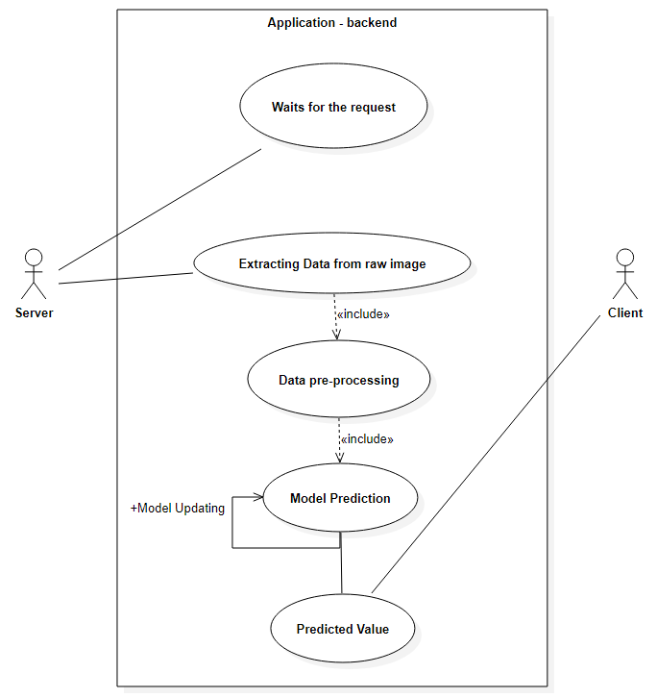
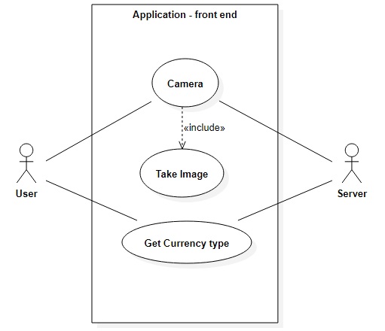
9. Use Case Diagram
Fig 9.1.1 Use Case Diagram Application Frontend
Fig 9.1.2 Use Case Diagram Application Backend

Slide 21
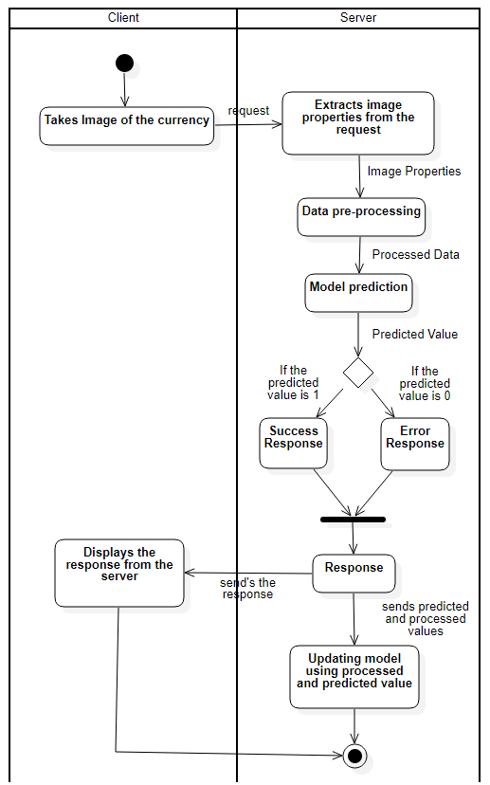
Activity Diagram
Fig 9.2 Activity Diagram

Slide 22
10. Code

Slide 23
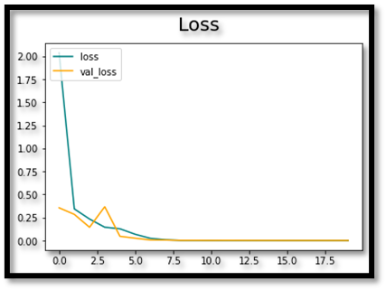
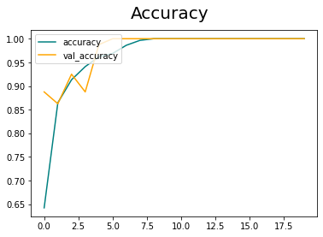
11. Result and Analysis
Fig 11.1 Loss graph of the model
Fig 11.2 Accuracy graph of the model

Slide 24
12. Conclusion
In conclusion, image processing and machine learning techniques, particularly using convolutional neural networks (CNN), can be effective in detecting fake currency. By training a CNN model with a dataset of genuine and fake currency images, the model can learn to identify patterns and features that distinguish real from counterfeit bills.
This can be achieved by extracting relevant features from the currency images and feeding them into the CNN model, which can then learn to classify the bills as genuine or fake. The effectiveness of the model can be further enhanced by incorporating additional features such as texture, watermark, and micro-printing.
Overall, utilizing image processing and machine learning techniques can provide a reliable and efficient solution for detecting fake currency, which can help prevent economic fraud and ensure the integrity of financial transactions.
The accuracy which can have achieved 75%.

Slide 25
Future Enhancement
Multi-modal detection: Instead of relying solely on image processing, the system could incorporate additional modalities, such as audio or vibration, to detect fake currency. For example, a counterfeit bill may produce a different sound or vibration when tapped or swiped than a genuine bill.
Explainable AI: To increase transparency and trust in the system, the machine learning model could be designed to provide explanations or justifications for its predictions. This would help users understand why a particular bill was flagged as fake, and could also aid in debugging and improving the model.
Few-shot learning: Currently, a large amount of labeled data is required to train a machine learning model for fake currency detection. Few-shot learning techniques could reduce this requirement by enabling the model to learn from only a few examples.
Privacy-preserving techniques: To protect user privacy, the system could incorporate techniques such as federated learning or differential privacy, which enable the model to be trained on distributed data without revealing sensitive information.

Slide 26
Reference Paper
V. Kapare, S. Lokhande, and S. Kale, “Automatic Cash Deposite Machine With Currency Detection Using Fluorescent And UV Light,” vol. 3, pp. 309–311, 2020.
P. P. Binod Prasad Yadav, C. S. Patil, R. R. Karhe, “An automatic recognition of fake Indian paper currency note using MATLAB,” Certif. Int. J. Eng. Sci. Innov. Technol., vol. 9001, no. 4, pp. 2319–5967, 2020, [Online]. Available: http://www.ijesit.com/Volume 3/Issue 4/IJESIT201404_77.pdf.
S. Arya and M. Sasikumar, “Fake CurrencyDetection,” 2019 Int. Conf. Recent Adv. Energy Efficient Comput. Commun. ICRAECC 2019, pp.2019–2022, 2019, doi: 10.1109 /ICRAECC43874.2019.8994968.
A. Ghimire, S. Thapa, A. K. Jha, S. Adhikari, and A. Kumar, “Accelerating business growth with bigdata and artificial intelligence,” Proc. 4th Int. Conf.IoT Soc. Mobile, Anal. Cloud, ISMAC 2020, pp.441–448, 2020,doi:10.1109/ISMAC49090.2020.9243318a

Slide 27
Fake Indian Currency Note [Online]. Available:https://en.wikipedia.org/wiki/Fake_Indian_currency_note
Chinmay Bhurke, Meghana Sirdeshmukh, Prof. Mrs. M.S.Kanitkar, ―Currency Recognition Using Image Processing International Journal of Innovative Research in Computer and Communication Engineering, Vol. 3, Issue 5, May 2015
Trupti Pathrabe G and Swapnili Karmore 2011 Int. J. CompTrends Tech 152-156
Eshita Pilania, Bhavika Arora, ―Recognition of Fake Currency Based on Security Thread Feature of Currency‖ International Journal Of Engineering And Computer Science, ISSN: 2319-7242
P. Julia Grace, Ph.D., A. Sheema, ―A survey on Fake Indian Paper Currency Identification System‖ Grace et al., International Journal of Advanced Research in Computer Science and Software Engineering 6(7), July- 2016, pp. 340-345 ISSN: 2277 128X
Komal Vora, Ami Shah, Jay Mehta, ―A Review Paper on Currency Recognition System‖ International Journal of Computer Applications (0975 – 8887), Volume 115 – No. 20, April 2015

